Slide 1



High Level Process Flow
Summit
Flink Consumer
Flink ML
DB

Slide 2
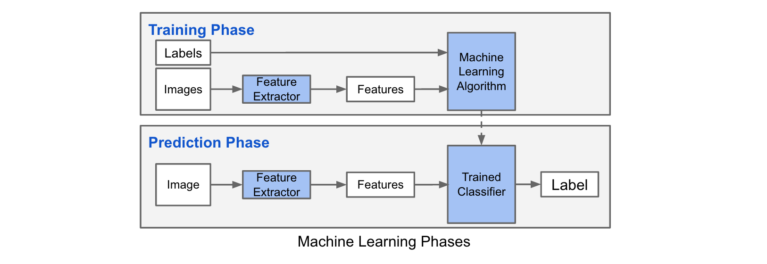



How to train a Machine Learning algorithm?

Slide 3
Training Decision Tree Model
Acquire Summit data
Parse Summit messages
Export data to Excel
Extract features
Label set of features
Identify unique messages
Train Decision Tree Model using training data
Validate results against manually labelled data

Slide 4
Process Summit Messages Via Kafka and Flink
Once the model was trained, we process over 1500 messages via ML.
The trained ML model predicted with 100% accuracy during our testing.
On a few occasions, a few records threw off the model.

